Slide 1
Agentic Coding
Song & Owen

Slide 2
Overview
(3 - 7)Starting
(8 - 12)How it works
(13 - 16)Interaction Paradigm
(17 - 18)Make Something
(19 - 23)Limits and Risks
(24 - 27)Ending

Slide 3
Part 1
Starting
Starting

Slide 4
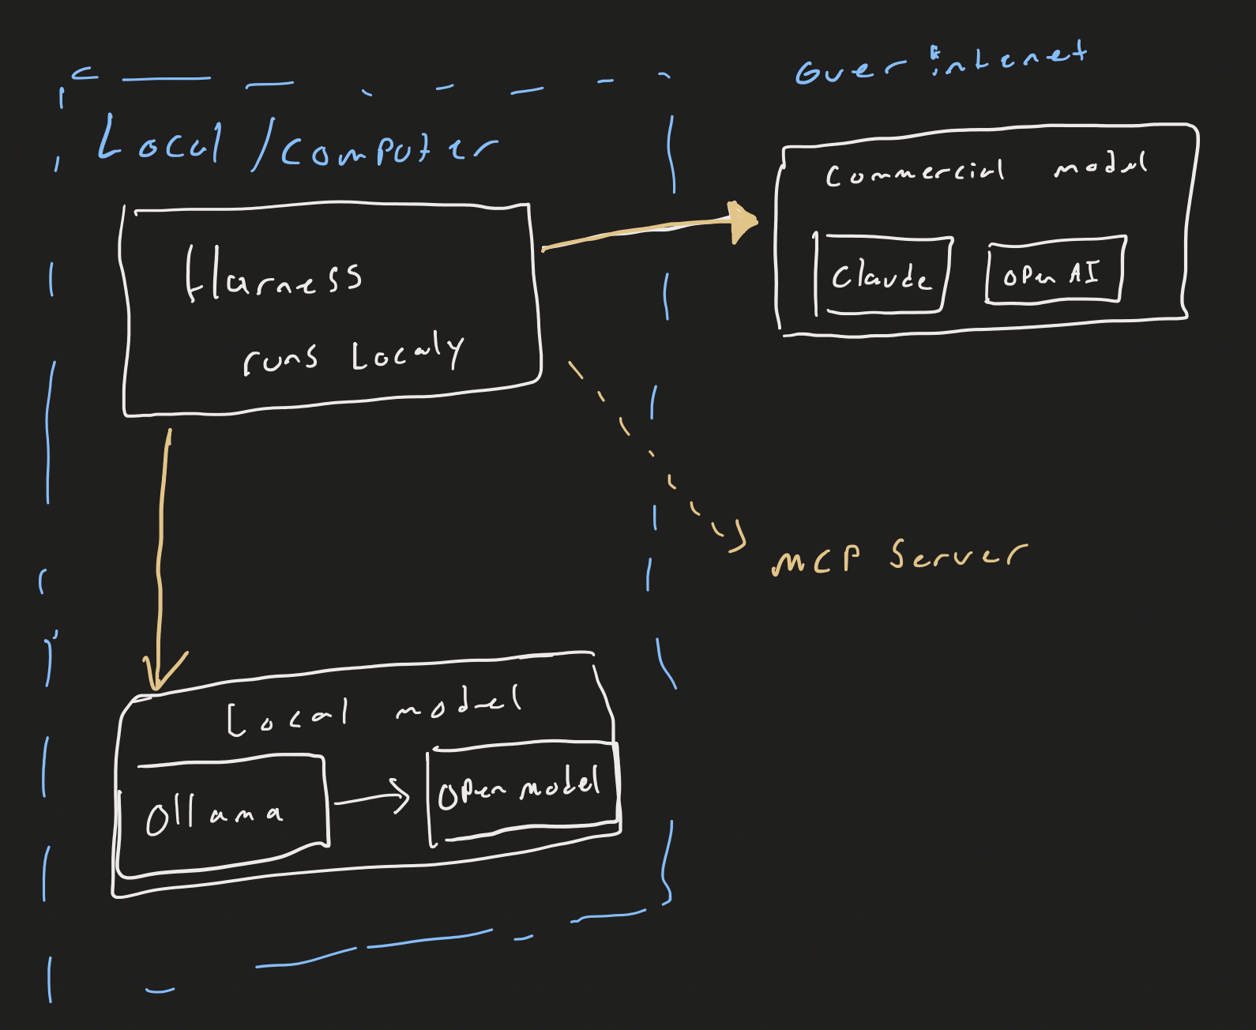
Different Setups
Commercial
Opencode Harness + Anthropic (Claude Opus 5.5)
OpenAI Codex
OpenAI (GPT 6 Astra)
A fee for every token. Your code and prompts leave your machine.
Local
Not implemented in testing
Ollama runs an open model. No token fee;
Other Tools
Other Connections
Starting

Slide 5
Costs and Setup
https://opencode.ai/v2/docs/models/#local
 | Commercial |  | Local Open Models
 | OpenCode + Claude | Open AI Coding Agent | OpenCode + Local Transformer Model (Other Presentation)
Token Cost | $4 in / $20 out per 1M tokens. Payed $10 | $[10] / $[50] per 1M tokens. Paid $10. | Electricity
Runs on | Commercial Servers, Through Claude API | Commercial Servers, Through OPEN AI | Local hardware
Requirements | Storage for context processing & internet connection | Storage for context processing & internet connection | X
OS | Windows, Mac, Linux | Web Browser | X
Setup | ReadMe.MD | ReadMe.MD | X
Starting

Slide 6
Setup OpenCode + Anthropic:
https://opencode.ai/v2/docs/models/#local
& other presentation
Install OpenCode
Can be done as a app, or through the terminal
Get An API Key
Generate a API key in the Anthropic Console
WARNING: Claude Pro or Max subscriptions dont work
Connect
In OpenCode, run /connect, choose Anthropic, paste the key.
Iterate and Build.
Starting

Slide 7
Open AI Setup
Set-up: Terminal
Application Connection set up: Microsoft Application Registration
Cost: ChatGPT monthly subscription $25/m.
Starting

Slide 8
Part 2
How it works
How it works

Slide 9
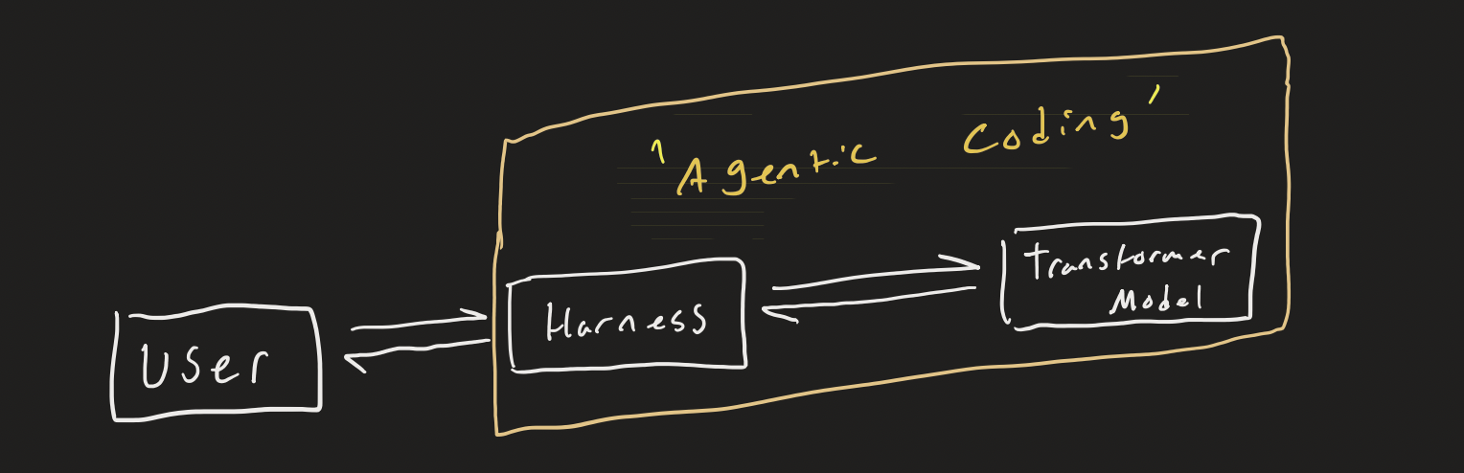
Agentic coding = Harness + Transformer Model
Harness - Everything except the transformer model.
A Transformer model can use tokens to:
take text input
provide text output
It cannot
Keep states
Run code
Know recent information
Set up an environment
What even is a harness?
How it works

Slide 10
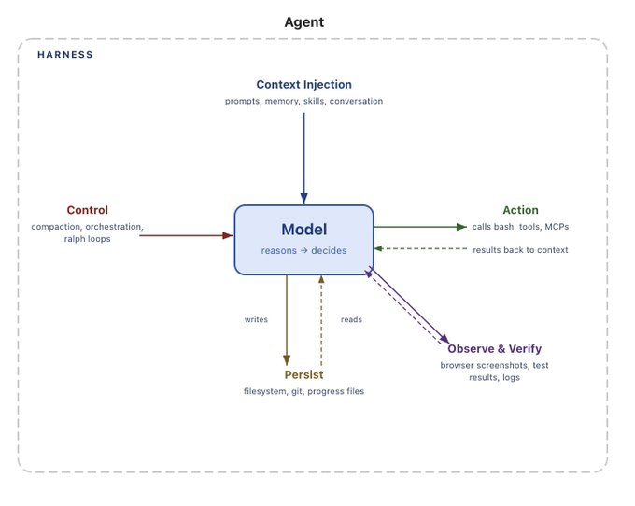
5 Harness Parts
Control (Air Traffic Control)
Governs how prompts are processed
Workflow loops
Context (Briefing packet)
The request, rules, how-to, and past conversation
Observe & Verify (Inspector)
Spots what went wrong and How
Action (Hands / Tools)
Acts through tools: Github, code, outside software
Persistence (Notebook)
Tracks changes, keeps code consistent
How it works

Slide 11
Adding context
Once weights are fixed, context injection is the only way to add information beyond the training data
Prompts, Projects, Rules(always loaded), and Skills(Loaded when relevant) allow lessons to cary between sessions
When a context window gets too large, the model will ‘compact’ its context into a shorter length
How it works

Slide 12
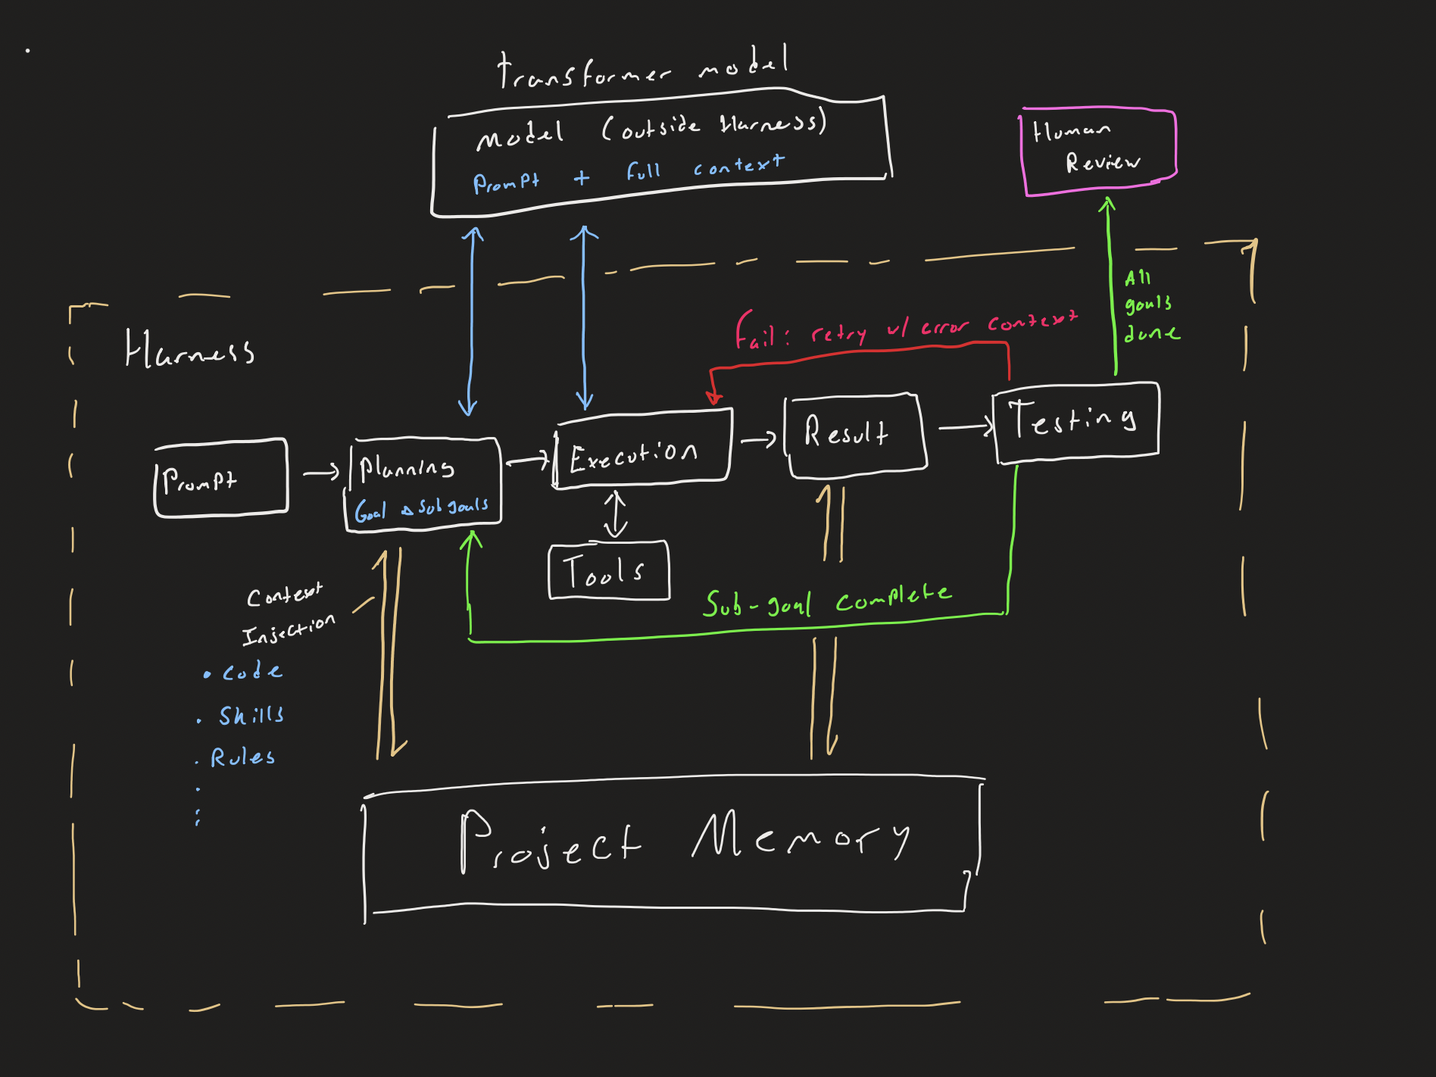
The Agent Loop
Human Review
Prompt(s) + Goal ←→ Model Full project context←→ Model
Context ←→ Memory ←→ Beyond
Sub-goal completed→ Planning
Goal completed → Human Review
Failed → Retry with Error
How it works

Slide 13
Part 3
Interaction Paradigm
Interaction Paradigm

Slide 14
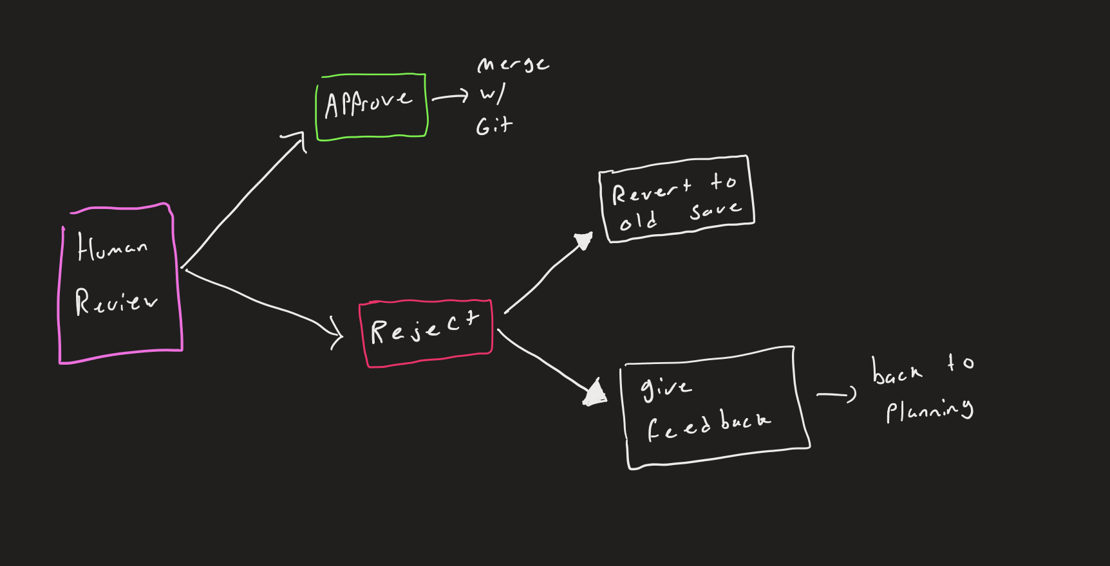
Interact every task loop
Prompt
Edit
Test
What you control
>
Context
Rules
Skills
Files
Permissions
Plan vs Build mode
Prompt
Approve: merge with git
Reject: revert to the old save, or give feedback and go back to planning
Interaction Paradigm

Slide 15
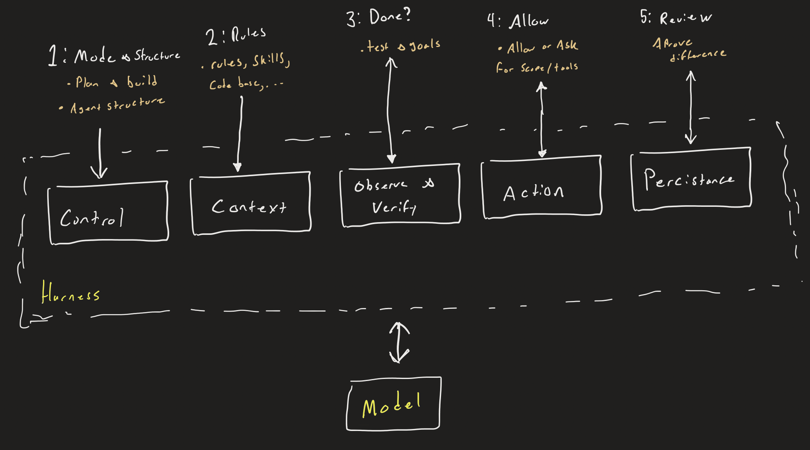
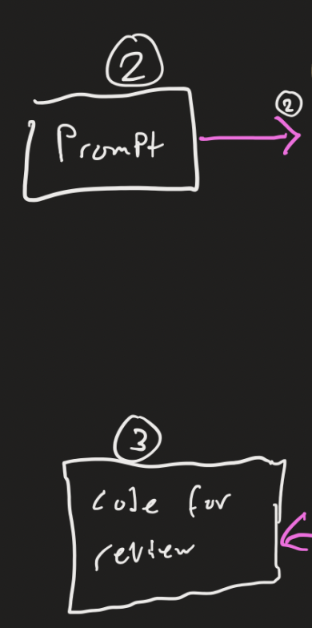
Where you can interact with the harness
Mode (plan vs. build)
Rules (AGENTS.md)
Done (tests),
Permissions (ask before edits and commands),
Review (read the diff, approve with git or reject).
Interaction Paradigm

Slide 16
Strengths and Weaknesses
Easy
Working in large existing code bases
Starting from nothing
Rapid prototyping
Use by non-coders
Hard
Collaboration: the diff shows what changed, not why
Repeatability: output is non-deterministic
Reviewing code you didn’t write
Non-deterministic coding problems: Multithreading problems
Interaction Paradigm

Slide 17
Part 4
LIVE DEMO
Make Something

Slide 18
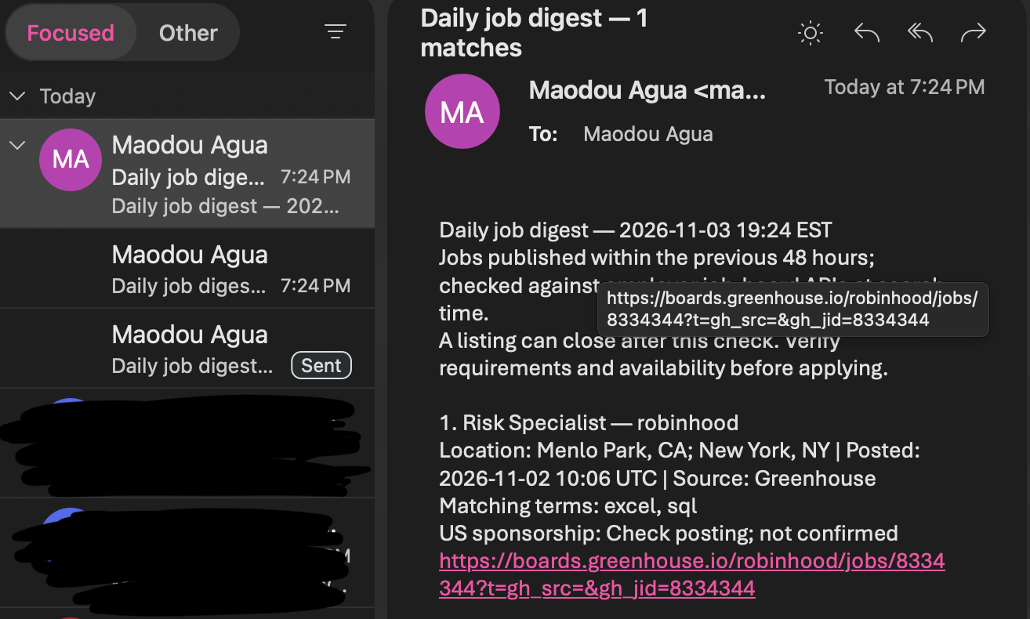
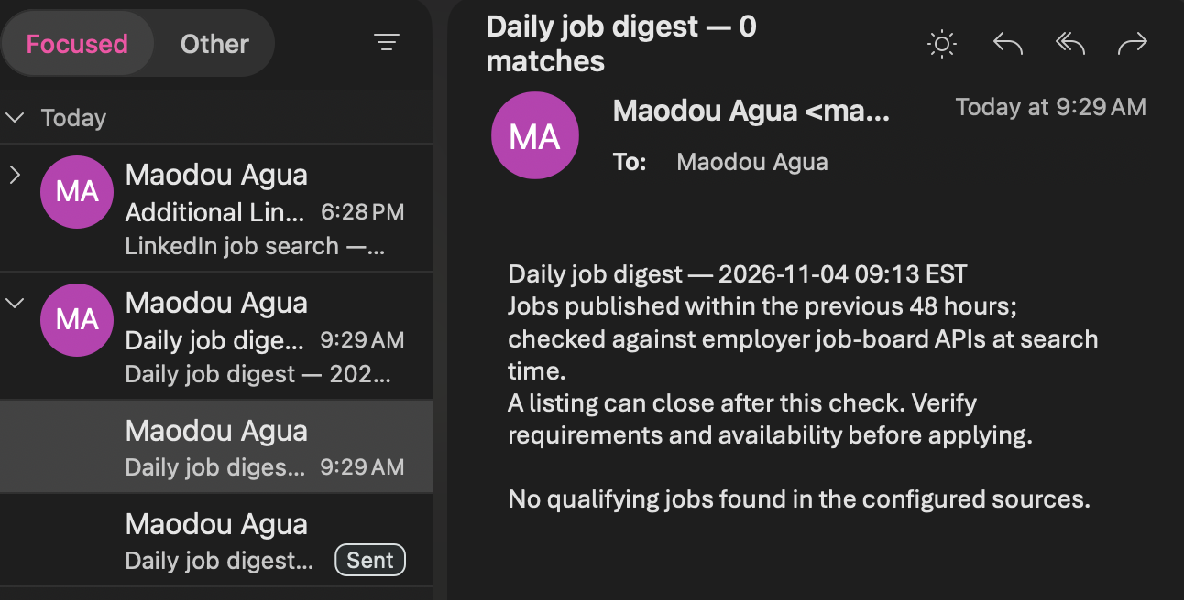
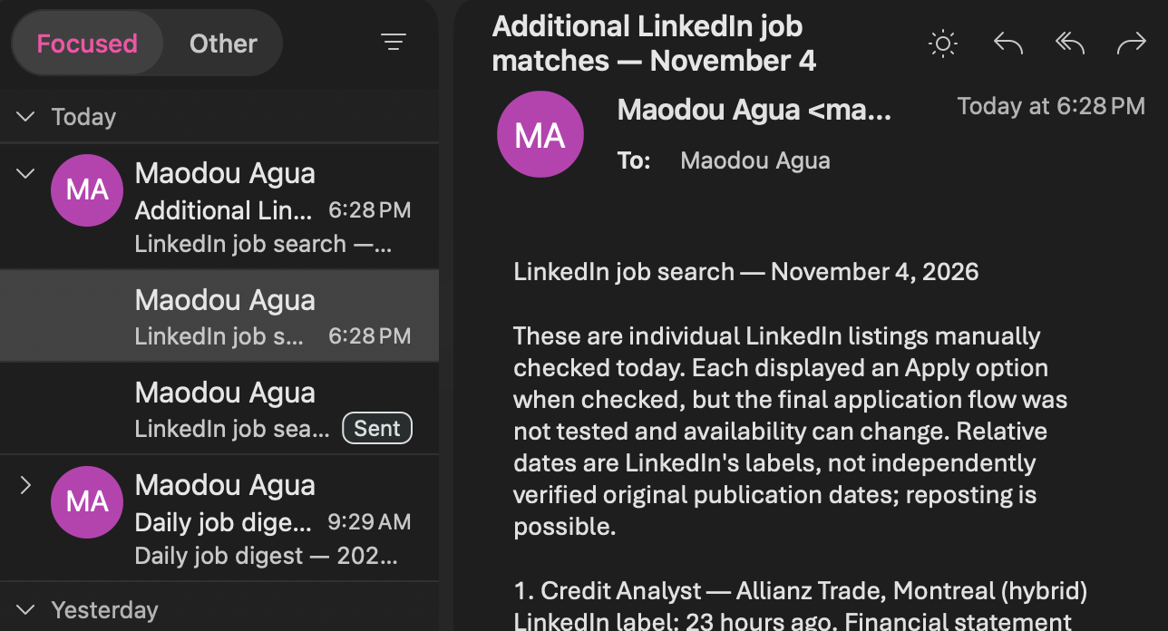
Demo Reflection
Make Something

Slide 19
Part 5
Limits and Risks
Limits and Risks

Slide 20
Digest sent no links
Stats for matches
49 Stripe and Coinbase listings rejected (unsupported URL formats). 0 jobs logged, no run time recorded. 1 poor match let through on the words Excel and banking.
Reasons found for failure
narrow coverage and imperfect filtering,
Improvements: enlarge the filter and update URL formats.
Limits and Risks

Slide 21
Limits and explanations
Accuracy and reliability: narrow coverage and imperfect filtering,
Bias and coverage,
Privacy,
Security.
Licensing.
Limits and Risks

Slide 22
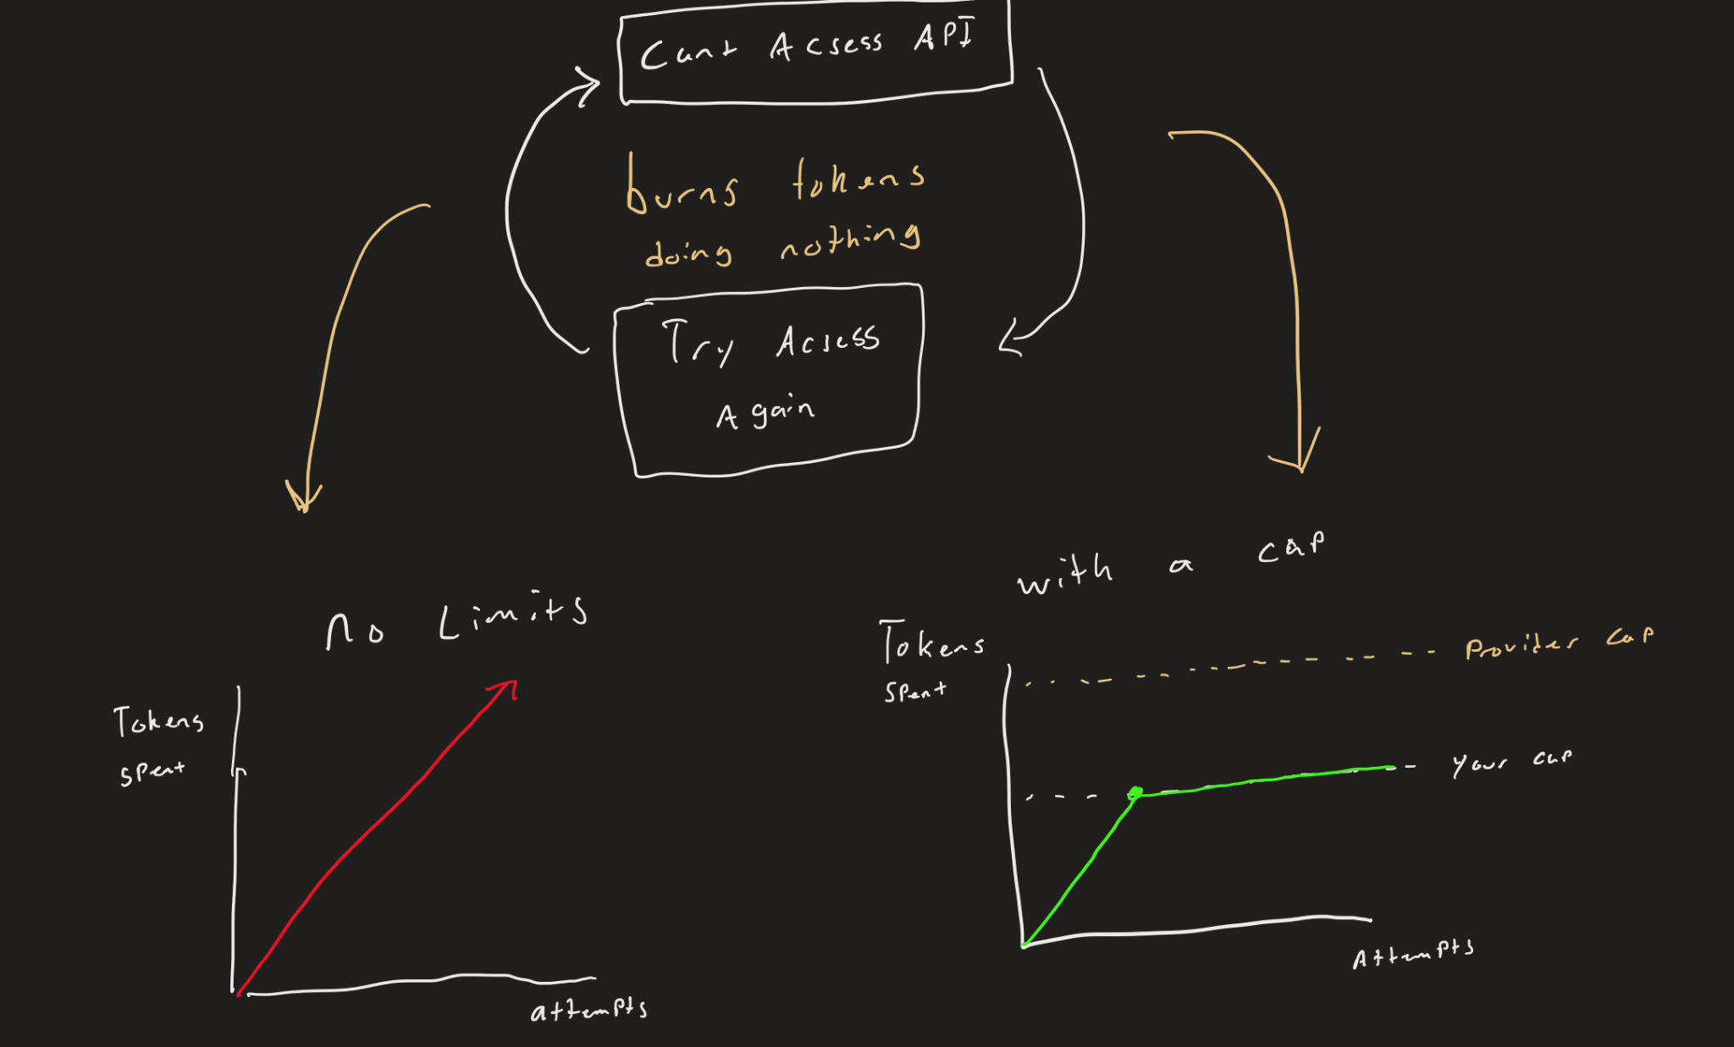
Limiting
An agent can get stuck in a loop: tokens skyrocket and no work gets done.
No limits: spending keeps climbing
With a cap: it stops at your cap; the provider cap is the backup
Limits and Risks

Slide 23
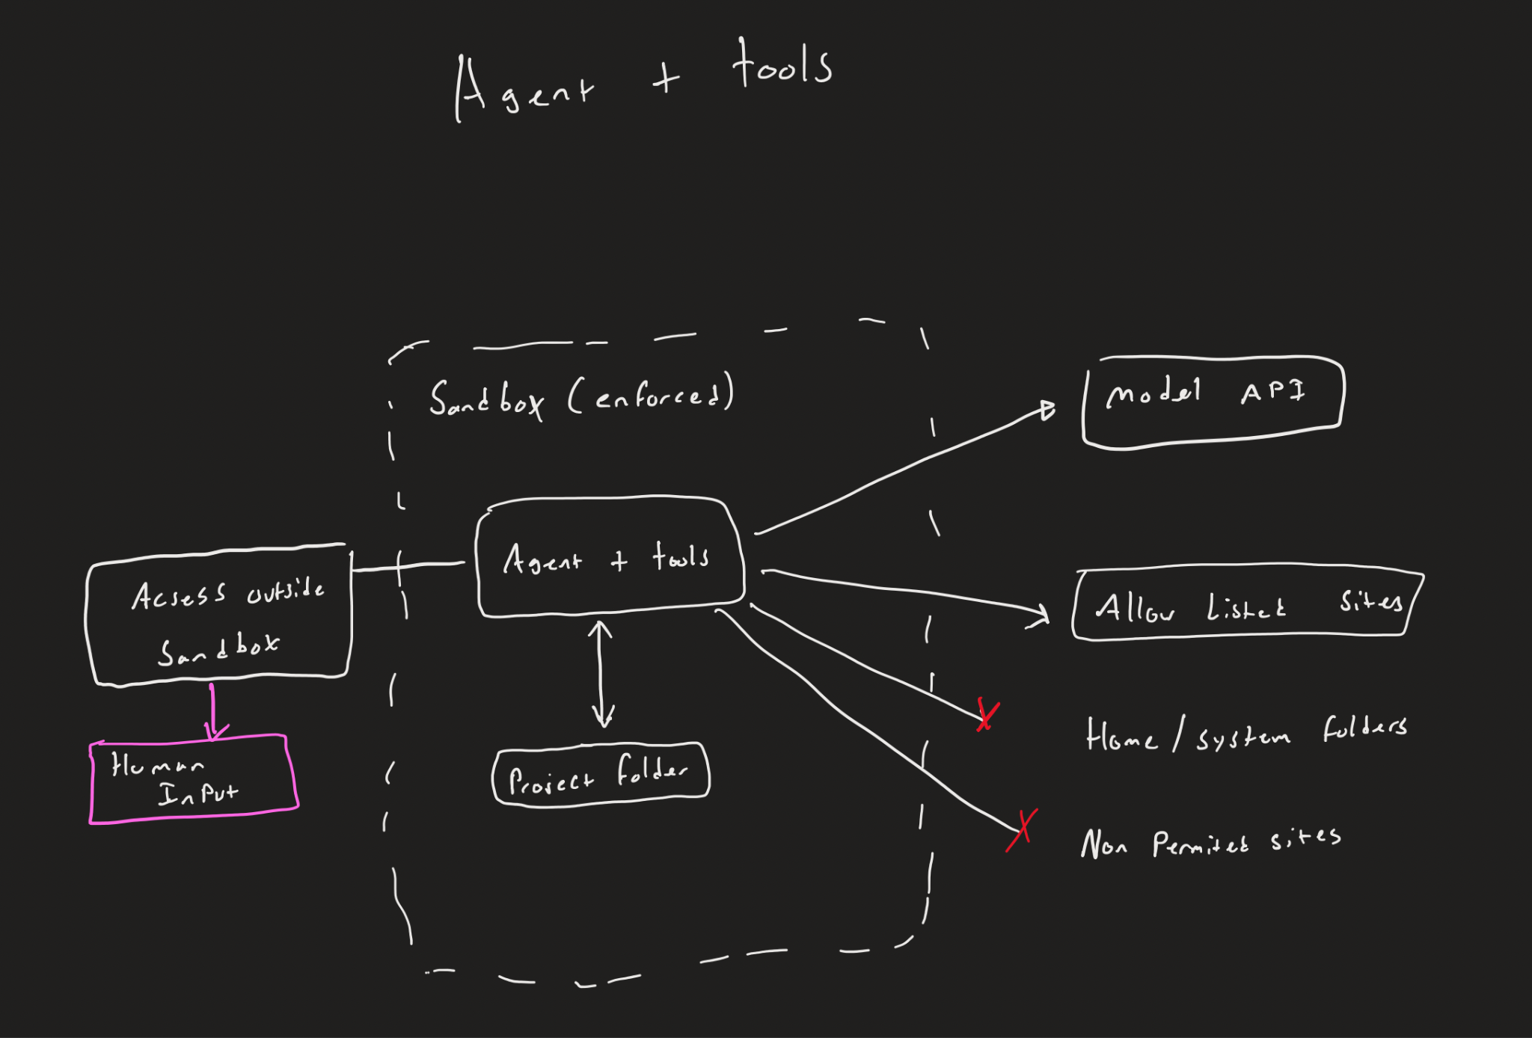
Sandboxing
With full file access, an agent can change things it shouldn’t, like the operating system.
Fix: strict limits on what it can reach, locally and online.
Our setup: no container or OS sandbox.
Limits and Risks

Slide 24
Part 6
Connection to final project

Slide 25
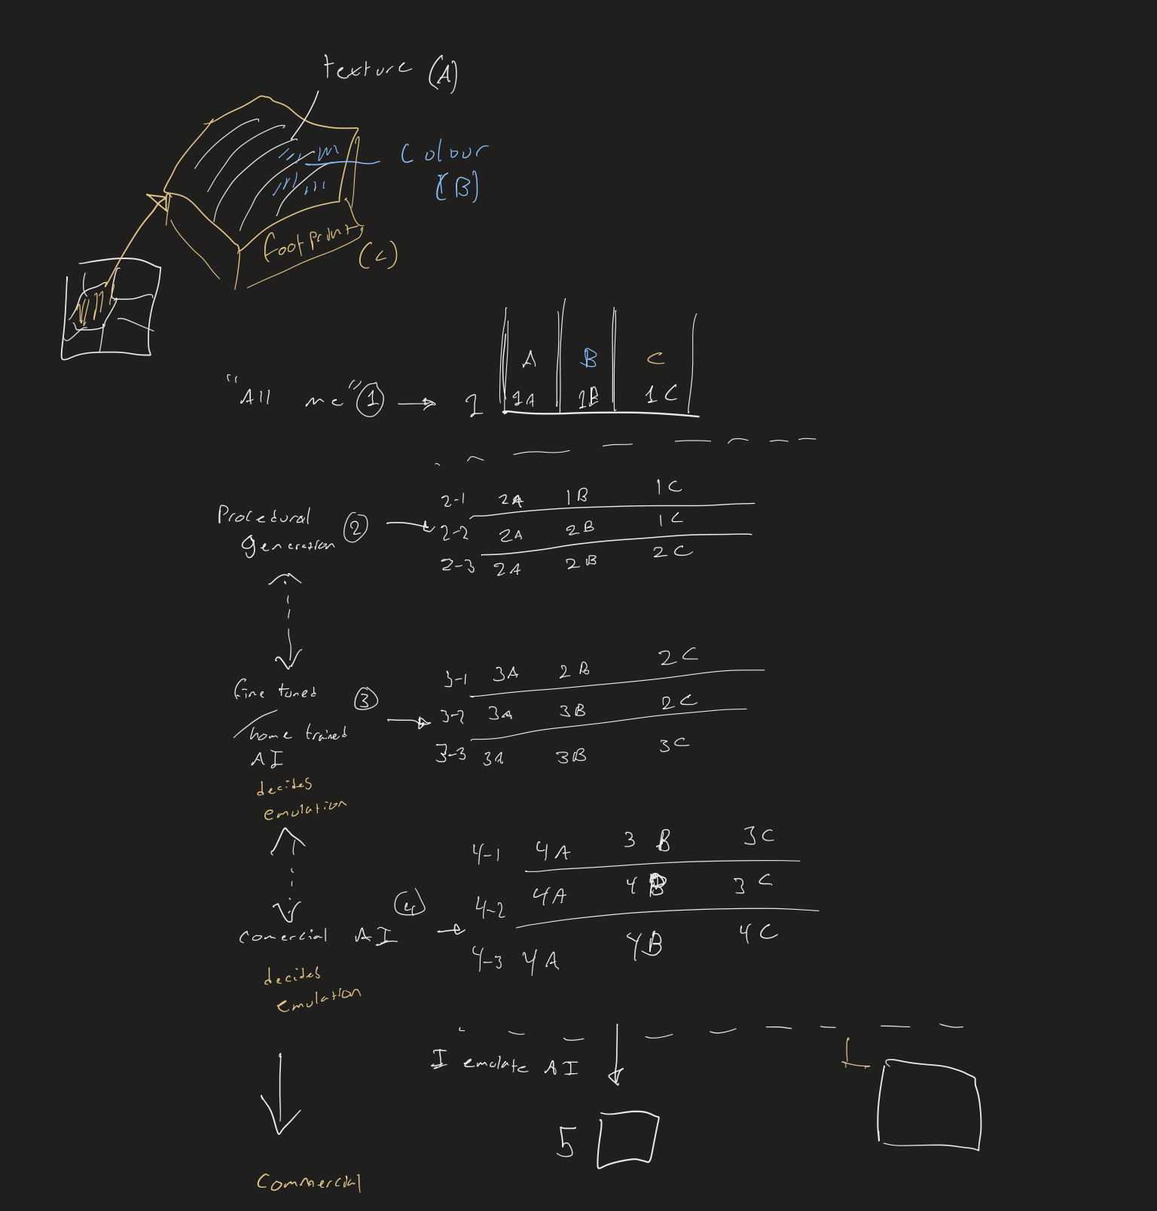
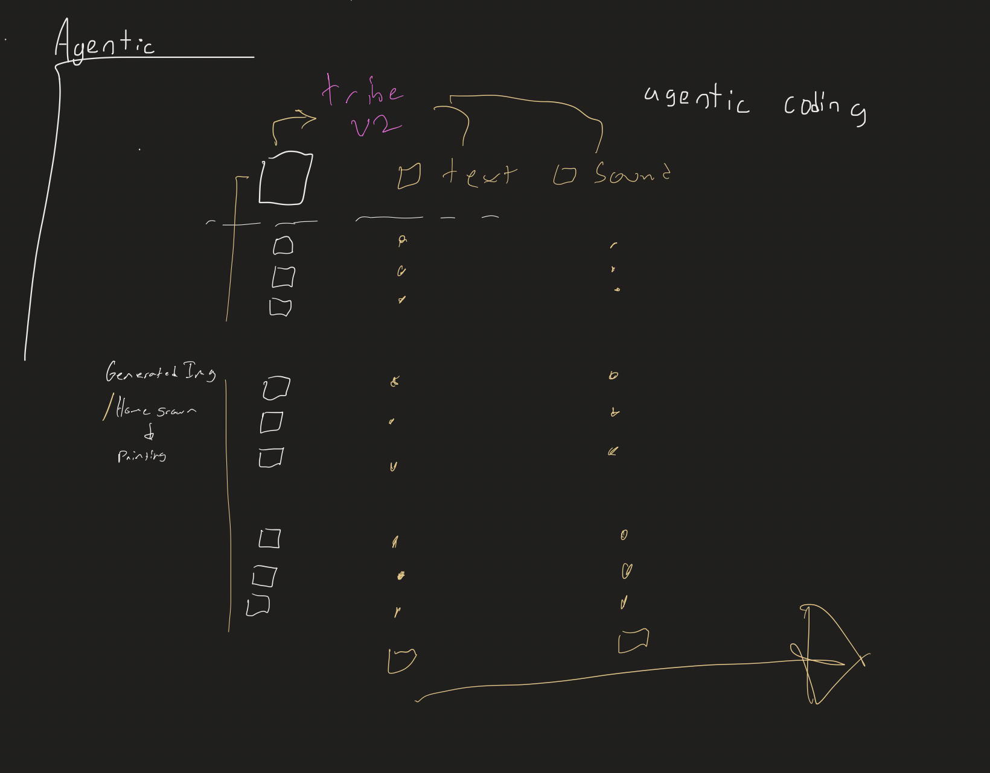

Slide 26
Conclusion & Questions

Slide 27
References
Anthropic. n.d. "Pricing." Claude Docs. Accessed November 5, 2026. https://platform.claude.com/docs/en/about-claude/pricing.
OpenAI. n.d. "API Pricing." OpenAI Developers. Accessed November 5, 2026. https://developers.openai.com/api/docs/pricing.
OpenCode. n.d. "Providers." OpenCode Docs. Accessed November 5, 2026. https://opencode.ai/docs/providers/.
[Author]. [Year]. "The Anatomy of an Agent Harness." LangChain (blog). Accessed November 5, 2026. https://www.langchain.com/blog/the-anatomy-of-an-agent-harness.
[Author]. [Year]. "Agentic Workflows Explained." Department of Product (Substack). Accessed November 5, 2026. https://departmentofproduct.substack.com/p/agentic-workflows-explained-an-in. Replace the title with the full title from the page, because the link is cut off.
[Author]. [Year]. "Agentic Coding Harnesses: A Comparison." Medium. Accessed November 5, 2026. https://prowe214.medium.com/agentic-coding-harnesses-a-comparison-4db34b87fd5c.

